Slide 1


Integrated Health Savings Accounts
Berkshire Health Group
December 18, 2018

Slide 2

WHAT IS A HEALTH SAVINGS ACCOUNT (HSA)?
Triple tax-advantaged account that allows money to be put aside to pay for qualified medical expenses.
HSA contributions are not subject to federal income tax.
Tax free earnings on dollars accumulating in the HSA.
Tax free withdrawals for qualified medical expenses.
The employee controls the money in their account. He/she can:
Use for eligible expenses incurred by themselves, spouse and qualified tax dependents.
Unused funds rollover from year to year.
Employees keep the money in the HSA account even if they change jobs.
Massachusetts does not tax HSA contributions. Employees should refer to their tax advisor to confirm how their state handles HSAs.
Notes:
Adult children can set up their own HSA to pay for their own medical expenses. For more information about tax dependents please see this IRS publication and review the Qualifying Child information:

Slide 3
HSA ELIGIBILITY REQUIREMENTS
    In order to contribute to an HSA, participants must meet the following criteria:
Must be enrolled in a qualified High Deductible Health plan (HDHP)
Cannot have other health coverage (see IRS Publication 969)
Cannot be enrolled in any part of Medicare or Medicaid. *The employee is enrolled in Medicare A automatically if they are receiving Social Security Benefits or Railroad Retirement Board Benefits.
Cannot be active in the military and have coverage through Tri-Care
Cannot be enrolled in a Full Scope Health FSA (including through a spouse’s plan) or have an FSA balance during the grace period
Cannot be listed as a dependent on someone else’s tax return

Slide 4
HSA ELIGIBILITY REQUIREMENTS, Cont.
Using HSA funds:
HSA account holders are eligible to use their HSA funds to pay for qualified medical expenses incurred by themselves, their spouse and their qualified tax dependents.
HSA Tax-Dependent Rule
When a child is no longer a tax-dependent, but covered on a parent’s High Deductible Health Plan medical expenses incurred by that child cannot be paid with the parent’s HSA funds.
If employees have a domestic partner that is their qualified tax dependent your employee may pay for their qualified medical expenses from their HSA.

Slide 5

Calendar Year FSA- Impact on HSAs
Is your FSA on a calendar year?
  The FSA plan year must be complete on 12/31/18 before an employee is eligible to make and receive contributions to an HSA on 1/1/19.
  If the FSA plan has a grace period, the account must be spent to a zero balance by 12/31/18 in order for an employee to be HSA eligible on 1/1/19.
  If the FSA plan offers a carryover provision, FSA balances up to $500 could be rolled into a HSA compliant Limited Purpose FSA effective 1/1/19. If an LPFSA is not offered, the funds would be forfeited.

Slide 6

Plan Year FSA- Impact on HSAs
Does your FSA plan year begin 7/1/18?
  The FSA plan year must be complete on 6/30/18 before an employee is eligible to make and receive contributions to an HSA on 7/1/18.
  If the FSA plan has a grace period, the account must be spent to a zero balance by 6/30/18 in order for an employee to be HSA eligible on 7/1/18.
  If the FSA plan offers a carryover provision, FSA balances up to $500 could be rolled into a HSA compliant Limited Purpose FSA effective 7/1/18. If an LPFSA is not offered, the funds would be forfeited.

Slide 7
HSA CONTRIBUTIONS
2018 HSA contribution maximums
Contribution maximums are per tax year.
Employer and employee contributions count toward the maximum.
Employees who do not remain HSA eligible for an entire tax year will have an adjusted contribution maximum.
IRS publication 969 governs HSA accounts. We recommend review of this document by your internal counsel and tax professional http://www.irs.gov/pub/irs-pdf/p969.pdf.
Maximum | For…
$3,450 | Account holders with individual coverage
$6,900 | Account holders with family coverage
$1,000 | Catch up contribution for account holders 55+

Slide 8
HSA BEHIND THE SCENES
At Your Medical Visit
Employee shows his/her Blue Cross ID card to the health care provider.
  Behind The Scenes
  Health care provider bills Blue Cross.
  Blue Cross processes the claim.
  Blue Cross sends the employee a claim summary to show how the claim was processed.
  Blue Cross sends claim information to HealthEquity.
  The provider bills the employee directly.
  At your Pharmacy
  Employee shows his/her Blue Cross ID card to the Pharmacy
  Blue Cross processes the pharmacy claim and applies the cost toward the deductible if applicable.
  Pharmacy will then charge the member for this amount at the point of service.

Slide 9

Behind the Scenes HSA Enrollment
Timeline is dependent on groups being active, enrollment processed, and responsiveness of the Account/Broker
Payments can now be generated from the HSA accounts
HSA balance transfers may be initiated
For active groups, HSA Enrollments are sent to HealthEquity the following business day
If member passes CIP a Welcome Kit and Debit Card will be issued
Account Contact will receive a Welcome Email to have a Portal Orientation Call
HSA accounts are eligible for funding
HSA Enrollment is entered into the BCBS System
Employer Portal Overview
Members are passed through CIP *
30 days prior to guarantee debit cards by effective date
HSA Debit Cards are mailed 7 days after enrollment is processed at HealthEquity
Effective Date of HSAs
    * In compliance with the US PATRIOT Act, HealthEquity is required to verify the identity of all individuals opening an HSA. This process is referred to as the Customer Identification Process (CIP). If HealthEquity is not able to verify the identity of one of your employees based on the information received on your enrollment file, they will reach out to your employee to request additional documentation.

Slide 10
Employer Responsibilities
Beginning of Plan Year Responsibilities
Obtain consent from employees to open HSA on their behalf, certify they meet eligibility criteria
  The enrollment language and consent can be added to your HRIS system or you can capture consent on the HSA deduction form.
  Note: This form can be used for your records and does not have to be sent to BCBSMA
Set up HSA deduction code through payroll
Capture employee’s contributions amounts and send to HEQ
Throughout the Year
Regularly review the contribution history reports and share with payroll for accuracy
Have a scheduling process to allow employees to change contributions through the year (i.e. monthly, quarterly etc.)
End of Year Responsibilities
Report all HSA contributions (employer and employee) onto employee W2s

Slide 11
**CIF** Covered in Full
Medical Plan Design
Plan Design Features | Current (HMO Deductible FY18) | Proposed HSA (HMO Deductible FY18)
Deductible | $250 Ind $750 Family | $2,000 Ind/ $4,000 Family
Out of Pocket Maximum | $2,000Ind/$4,000Family Medical $3,000Ind/$6,000 Family RX | $5,000/$10,000 Includes Medical and RX
Preventative, Routine Physical | Covered in Full** | Covered in Full**
Office Visit Copays | $20/$35 copay PCP/Specialist | Deductible then CIF**
Inpatient Surgery | Deductible then $500 copay | Deductible then CIF**
Day Surgery | Deductible then $150 copay | Deductible then CIF**
ER | Deductible, then $100 copay | Deductible then CIF**
MRI/CT/PET*copay per procedure | Deductible then $100 copay | Deductible then CIF**
Diagnostic X-Ray/ Lab Work | Deductible then CIF** | Deductible then CIF**
PT and OT (100 visits/year combined) | $20 copay per visit | Deductible then CIF**
Chiropractic Care | $20 copay per visit | Deductible then CIF**(20 visit limit)
DME | 20% coinsurance after Deductible | Deductible then CIF**
Pharmacy | Retail: $10/25/50 Mail: $20/50/110 | Deductible then Retail: $10/30/65 Mail: $25/75/165
Fitness and Weight Loss Benefit | $300/$150 per family per cal year | $300/$150 per family per cal year

Slide 12
**CIF Covered in Full
Medical Plan Design, Cont.
Plan Design Features | Current (PPO Deductible FY17) *In Network | Current (PPO Deductible FY17) *Out of Network | Proposed HSA (PPO Deductible FY18) *In Network | Proposed HSA (PPO Deductible FY18) *Out of Network
Deductible | $250 Ind/$750 Family | $400ind/ $800 Family | $2,000Ind/$4,000 Family | $2,000Ind/$4,000 Family
Out of Pocket Maximum | $2,000ind/$4,000 Family Medical $3,000Ind/$6,000 Family RX | $3,000 per member | $5,000Ind/$10,000Family Medical/RX combined in and out of network. | Combined with in network
Routine Physical | CIF** | 20% coinsurance | CIF** | 20% coinsurance after deductible
Office Visit Copays | $20/$35 PCP/Specialist | 20% coinsurance | Deductible then CIF** | 20% coinsurance after deductible
Inpatient Surgery | $500 copay after deductible | 20% coinsurance after deductible | Deductible then CIF** | 20% coinsurance after deductible
Day Surgery | $150 copay after deductible | 20% coinsurance after deductible | Deductible then CIF** | 20% coinsurance after deductible

Slide 13
Medical Plan Design
Plan Design Features | Current (PPO Deductible FY17) *In Network | Current (PPO Deductible FY17) *Out of Network | Proposed HSA (PPO Deductible FY18) *In Network | Proposed HSA (PPO Deductible FY18) *Out of Network
ER | Deductible then $100 Copay per visit | Deductible then $100 Copay per visit | Deductible then CIF** | Deductible then CIF**
MRI/CT/PET Scan | Deductible then $100 copay | 20% coinsurance after deductible | Deductible then CIF** | 20% coinsurance after deductible
Diagnostic X-Ray/ Lab Work | Deductible then CIF** | 20% coinsurance after deductible | Deductible then CIF** | 20% coinsurance after deductible
PT and OT (100 visits/year combined) | $20 copay per visit | 20% coinsurance | Deductible then CIF** | 20% coinsurance after deductible
Chiropractic Care | $20 copay per visit | 20% coinsurance | Deductible then CIF** | 20% coinsurance after deductible
DME | 20% coinsurance after deductible | 20% coinsurance after deductible | Deductible then CIF** | 20% coinsurance after deductible
Pharmacy | Retail: $10/25/50 Mail: $20/50/110 | N/A | After deductible: Retail:$10/30/65 Mail:$25/75/165 | N/A
Fitness/Weight Loss Benefit | $300/$150 per family per cal year | N/A | $300/$150 per family per cal year | N/A

Slide 14
Individual Coverage Scenario- Average Medical Plan Use
Individual Coverage Scenario- Average Medical Plan Use
Estimated Member Cost | Network Blue HMO | H.S.A. Qualified HMO
Annual Premium est. 25% employee cost | $2,190 | $1,818
Deductible | $250 | $2,000 (combined medical and Rx)
Preventive Care | $0 | $0
1 Prescription (tier 2, retail) | $25 | $150
1 Regular Sick Visits | $20 | $120
1 Specialist appoinments | $35 | $150
Subtotal | $2,270 | $2,238
Health Savings Account Funding | N/A | $1,000
Total Estimated Cost | $2,522 | $1,238
Notes:
Karen is enrolled with Individual coverage.
She visits her primary care for her yearly physical
She has one sick visit requiring a prescription antibiotic
She sees her dermatologist for a yearly skin check

Slide 15
Individual Coverage Scenario- Higher Medical Plan Use
Estimated Member Cost | Network Blue HMO | H.S.A. Qualified HMO
Annual Premium est. 25% employee cost | $2,190 | $1,818
Deductible | $250 | $2,000 (combined medical and Rx)
Preventive Care | $0 | $0
3 Prescriptions (tier 2) | $75 | $450
2 Regular Sick Visits | $40 | $240
2 Specialist appoinments | $70 | $300
1 MRI (250 ded +100 copay) | $350 | $1,010
5 Physical Therapy Visits | $100 | $0
Subtotal | $2,825 | $3,818
Health Savings Account Funding | N/A | $1,000
Total Estimated Cost | $2,825 | $2,818
Notes:
Kevin is enrolled with individual Coverage
He sees his primary care for his yearly physical
He has 2 sick visits and 3 prescriptions
He has 2 follow up appointments with a specialist
1 MRI and
5 PT visits

Slide 16
Family Coverage Scenario- Average Medical Plan Use
Estimated Member Cost | Network Blue HMO | H.S.A. Qualified HMO
Annual Premium est. 25% member cost | $5,871 | $4,872
Deductible | $750 | $4,000 (combined medical and Rx)
Preventive Care | $0 | $0
Monthly Blood Pressure Medication (tier 1) | $120 | $156
Monthly Rx- Cholesterol Medication (tier 1) | $120 | $396
Monthly Type II Diabetes Prevention Rx (tier 1) | $120 | $360
1 Regular Sick Visit | $20 | $120
2 Specialist appoinments | $70 | $300
Subtotal | $6,321 | $6,204
Health Savings Account Funding | N/A | $2,000
Total Estimated Cost | $6,321 | $4,204
Notes:
John and his wife are enrolled with family coverage
They both have their yearly physicals
John takes monthly medications for high cholesterol, high blood pressure and a diabetes prevention medication
John sees his cardiologist and an endocrinologist once a year
John’s wife has one sick visit

Slide 17
Family Coverage Scenario- Higher Medical Plan Use
Family Coverage Scenario- Higher Medical Plan Use
Estimated Member Cost | Network Blue HMO | H.S.A. Qualified HMO
Annual Premium est. 25% member cost | $5,871 | $4,872
Deductible | $750 | $4,000 (combined medical and Rx)
Preventive Care | $0 | $0
Monthly Flovent Prescription (Tier 2- mail) | $200 | $1,700
5 Regular Sick Visits | $100 | $750
3 Throat Cultures | $60 | $102
1 MRI ($250 ded.+ $100 copay) | $350 | $1,448
Inpatient Surgery ($250 deductible +$500 copay) | $750 | $0
10 Physical Therapy Visits | $200 | $0
1 ER Visit ($100 copay) | $100 | $0
Subtotal | $7,631 | $8,872
Health Savings Account | N/A | $2,000
Total Estimated Cost | $7,631 | $6,872
Notes:
Jen, her husband and their two children are covered on a family plan
All have their yearly physicals
One of the children has asthma and takes flovent
They have 5 sick visits and 3 negative throat cultures
One of the children hurts her knee in soccer and needs an MRI
Jen’s husband has surgery and PT
They have one ER visit due to a possible concussion

Slide 18
Appendix

Slide 19

TRANSFERRING HSA FUNDS
An employee can keep their HSA balance with their current administrator or roll over funds to their HealthEquity HSA.
  Transfers must be initiated after the HealthEquity HSA plan effective date.
  There may be a brief blackout period as funds transfer from the prior custodian.
Transferring or rolling over funds is simple:
  Download the Transfer/Rollover Form at
  www.healthequity.com/form
  Complete the form and submit it to HealthEquity
  via email, mail or fax.

Slide 20
THE VALUE OF INTEGRATION
Client Experience
  Medical and HSA enrollment is sent to Blue Cross
  Eligibility information is sent daily from Blue Cross to HealthEquity
Member Experience
  Single sign-on from MyBlue member portal after the medical effective date. Members can log in to HealthEquity directly prior to their effective date.
  Medical and dental claims information is sent weekly and prescription drug claims are sent twice a month.
  Access HSA funds:
    Debit Cards
    Online Portal
    Mobile Application
  Robust, easy to use portal for total account management
      Convenient reimbursement options
      Mutual fund investing with unlimited trades for balances above $2,000
  Members can reach HealthEquity by calling Blue Cross or calling direct
      Intelligent call routing
  24/7/365 HealthEquity HSA specialists availability

Slide 21
HEALTHEQUITY FEE SCHEDULE
Monthly HSA Administrative Fee
$2.75 per active account per month | The monthly administrative fee of $2.75 is paid by the employer for active employees. Once the employee is no longer enrolled in a qualified medical plan with an integrated HSA, the account will convert to retail and the employee will be responsible for a monthly administrative fee of $3.95.
Paid by the employer
Potential HSA Account Holder Fees
Debit Card |  | Up to 3 Free
Additional Debit Cards |  | $5
Debit Card and Online Transactions |  | Free
Paper Statement (monthly fee) ** The fee is automatically charged unless the employee opts out of paper statement. |  | $1
Reimburse Yourself by Check |  | $2
Stop Payment (per request) |  | $20
Overdraft (per transaction) |  | $20
Deposit Return (per transaction) |  | $20
Close Account |  | $25

Slide 22
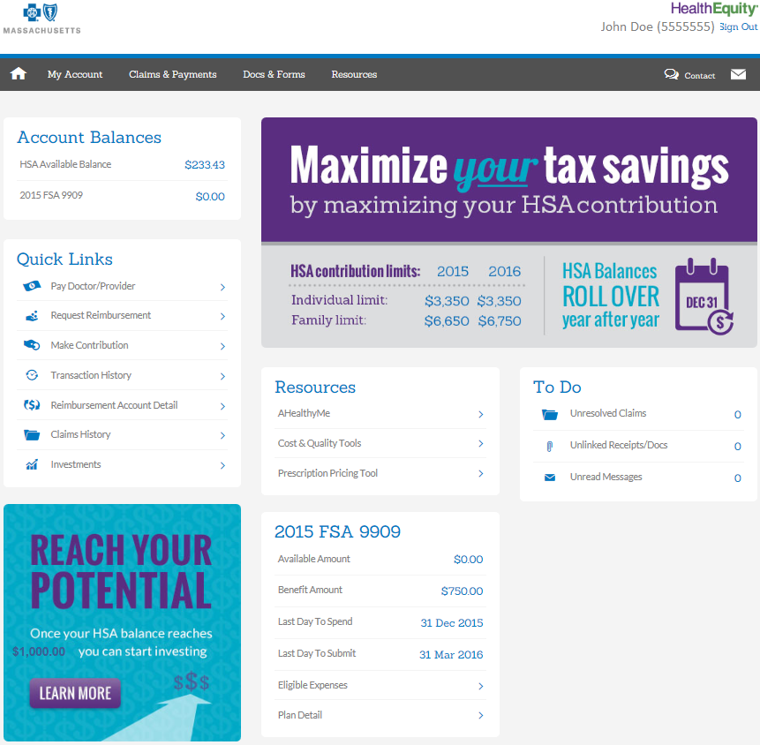
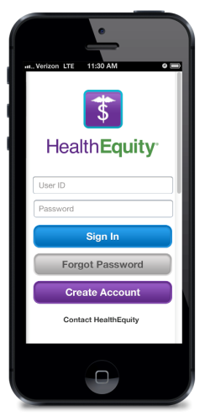


HEALTHEQUITY HSA MEMBER PORTAL
Use the HealthEquity Member Portal or Mobile App to:
Check balances
Review transactions
Review and submit claims
Submit documentation
Pay providers
Reimburse yourself
Access tax documents
TIP!
HealthEquity is GREEN!
Paper Checks: $2.00
Paper Statements $1.00
FREE! Direct Deposit!

